Slide 1
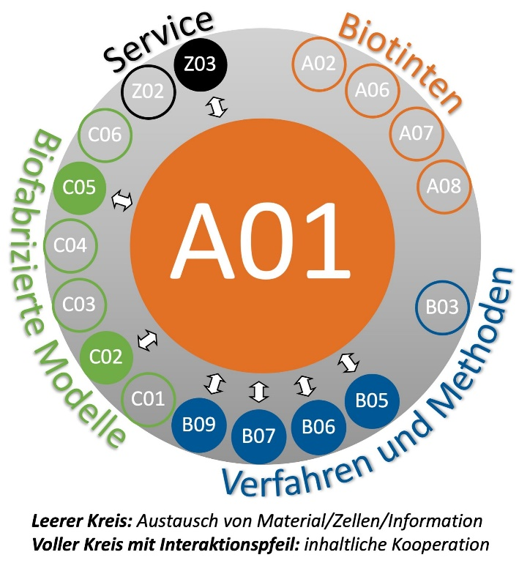
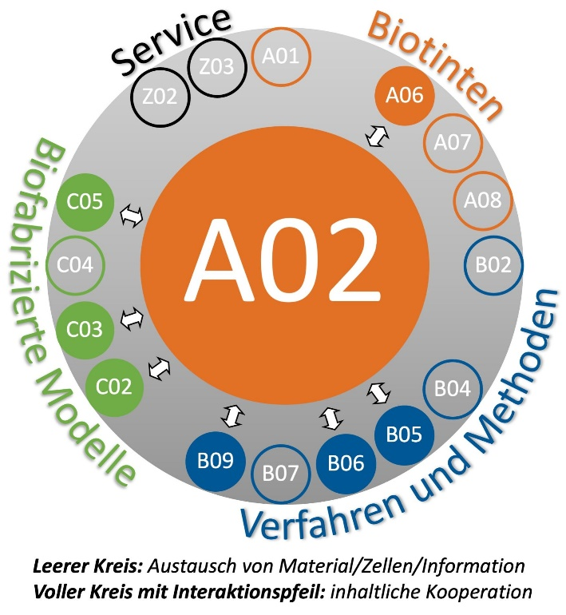
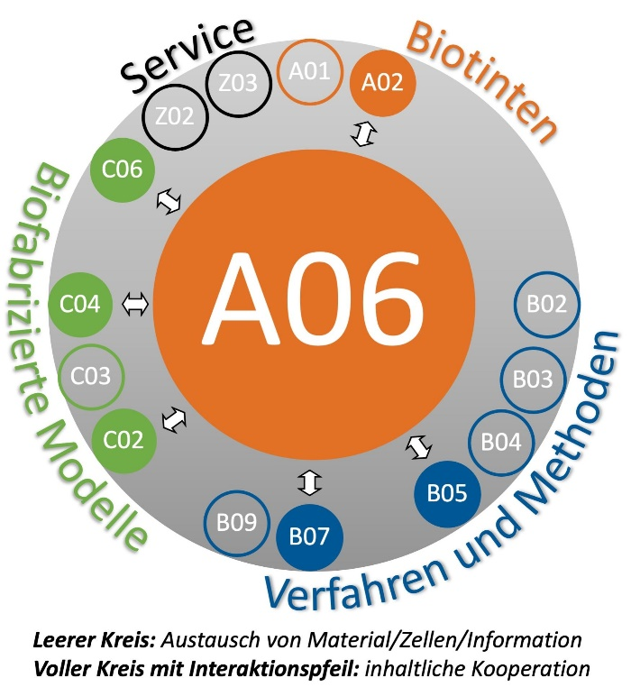
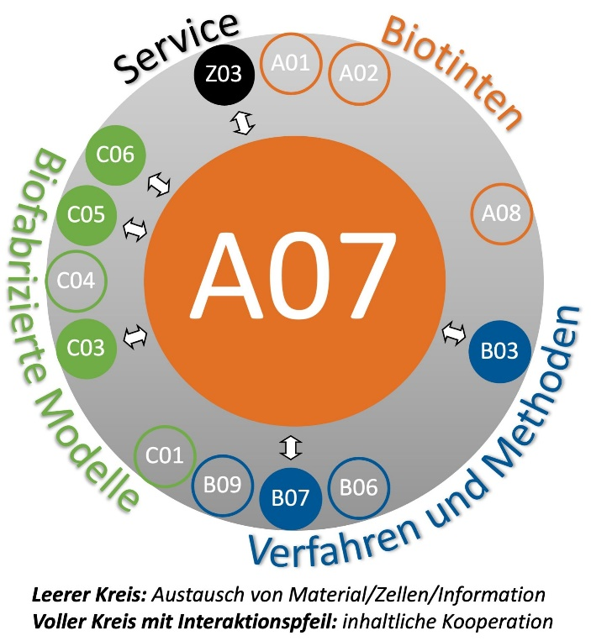
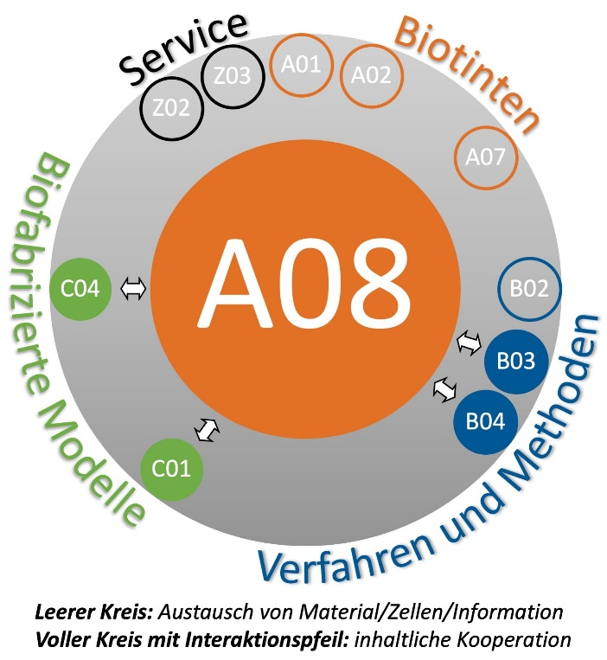
A-Subproject logos
Position within the SFB/ Interaction button

Slide 2
Project Logo
Size 10x15,7cm
Project Title
PI¹, PI² ,PI³, PhD¹, PhD², PhD³
¹Institute, University
²Institute, University
³Institute, University
Summary/Overview
Main results/Preliminary work
The quick brown fox jumps over the lazy dog. The quick brown fox jumps over the lazy dog. The quick brown fox jumps over the lazy dog. The quick brown fox jumps over the lazy dog. The quick brown fox jumps over the lazy dog.
The quick brown fox jumps over the lazy dog. The quick brown fox jumps over the lazy dog. The quick brown fox jumps over the lazy dog. The quick brown fox jumps over the lazy dog. The quick brown fox jumps over the lazy dog.
The quick brown fox jumps over the lazy dog. The quick brown fox jumps over the lazy dog. The quick brown fox jumps over the lazy dog. The quick brown fox jumps over the lazy dog. The quick brown fox jumps over the lazy dog.
The quick brown fox jumps over the lazy dog. The quick brown fox jumps over the lazy dog. The quick brown fox jumps over the lazy dog. The quick brown fox jumps over the lazy dog. The quick brown fox jumps over the lazy dog.
The quick brown fox jumps over the lazy dog. The quick brown fox jumps over the lazy dog. The quick brown fox jumps over the lazy dog. The quick brown fox jumps over the lazy dog. The quick brown fox jumps over the lazy dog.
The quick brown fox jumps over the lazy dog. The quick brown fox jumps over the lazy dog. The quick brown fox jumps over the lazy dog. The quick brown fox jumps over the lazy dog. The quick brown fox jumps over the lazy dog.
Work packages and methods
Integration into interdisciplinary topics
The quick brown fox jumps over the lazy dog. The quick brown fox jumps over the lazy dog. The quick brown fox jumps over the lazy dog. The quick brown fox jumps over the lazy dog. The quick brown fox jumps over the lazy dog.
The quick brown fox jumps over the lazy dog. The quick brown fox jumps over the lazy dog. The quick brown fox jumps over the lazy dog. The quick brown fox jumps over the lazy dog. The quick brown fox jumps over the lazy dog.
The quick brown fox jumps over the lazy dog. The quick brown fox jumps over the lazy dog. The quick brown fox jumps over the lazy dog. The quick brown fox jumps over the lazy dog. The quick brown fox jumps over the lazy dog.
The quick brown fox jumps over the lazy dog. The quick brown fox jumps over the lazy dog. The quick brown fox jumps over the lazy dog. The quick brown fox jumps over the lazy dog. The quick brown fox jumps over the lazy dog.
Position within the SFB
Interaction button 20x20cm
The quick brown fox jumps over the lazy dog. The quick brown fox jumps over the lazy dog.
The quick brown fox jumps over the lazy dog. The quick brown fox jumps over the lazy dog.
The quick brown fox jumps over the lazy dog. The quick brown fox jumps over the lazy dog.
Universitätsklinikum
Würzburg

Slide 3
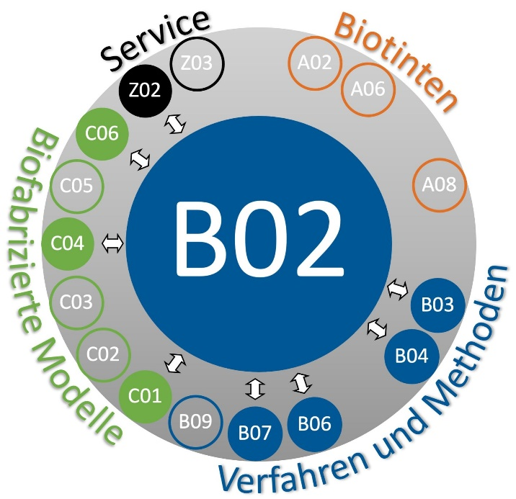
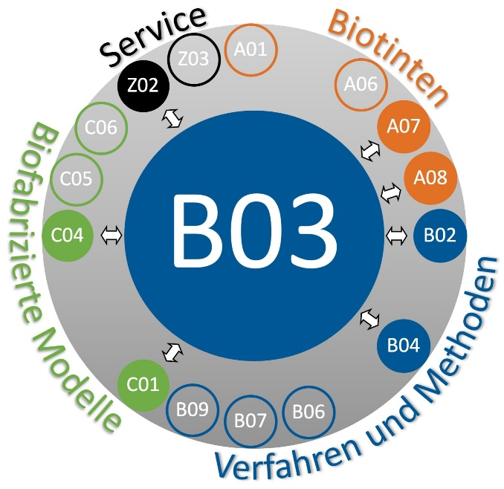
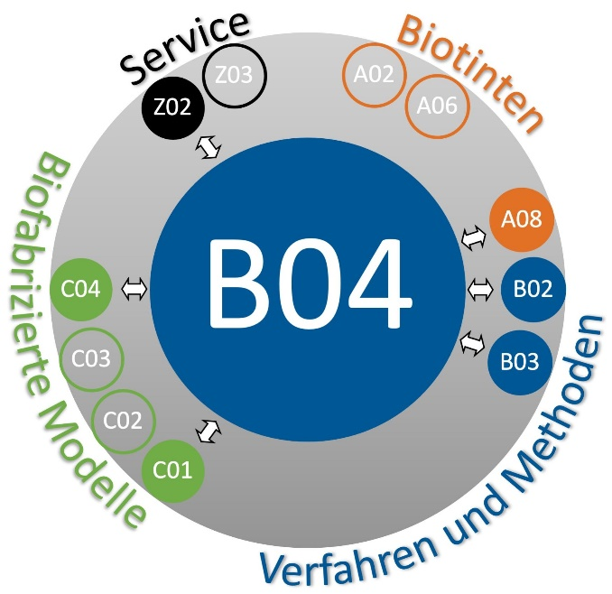
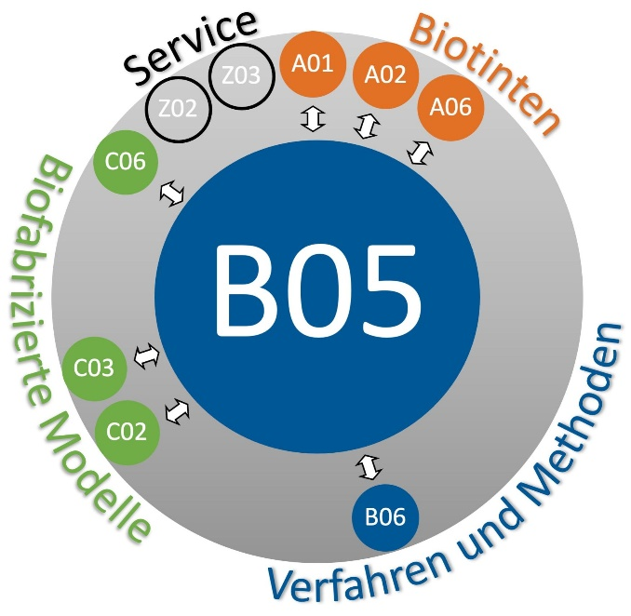
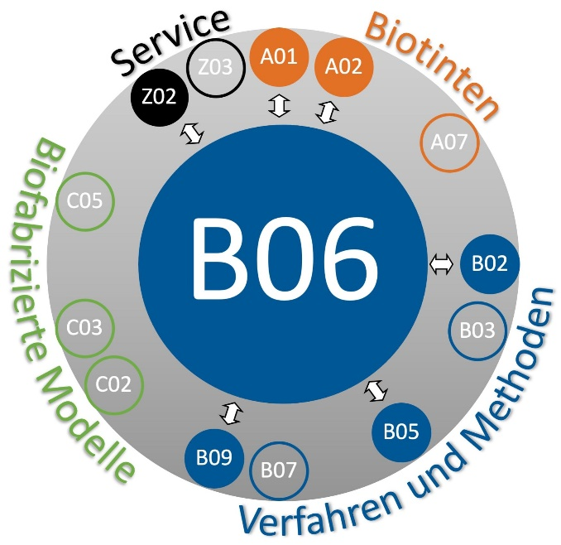
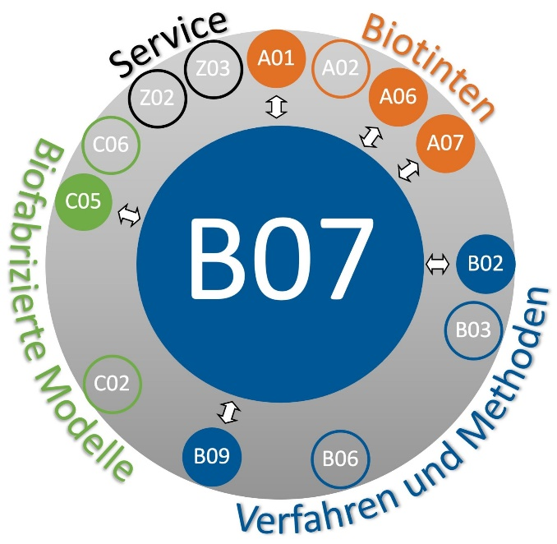
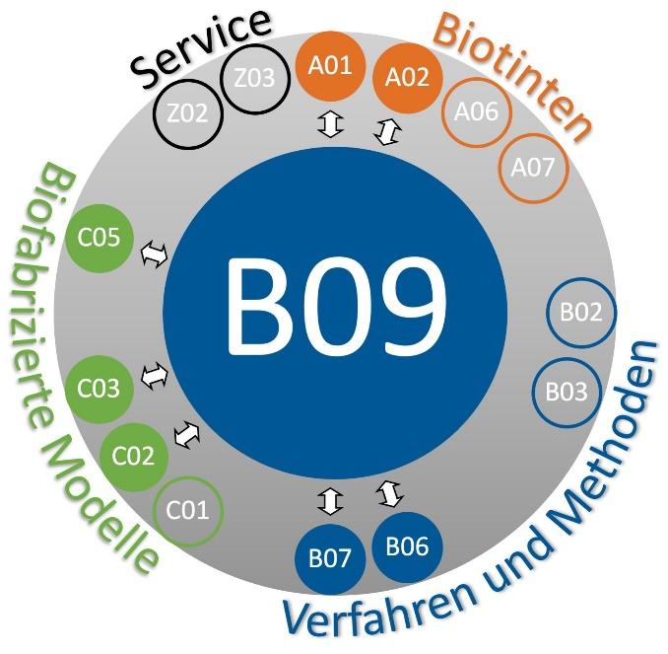
B-Subproject logos
Position within the SFB/ Interaction button

Slide 4
Project Logo
Size 10x15,7cm
Project Title
PI¹, PI² ,PI³, PhD¹, PhD², PhD³
¹Institute, University
²Institute, University
³Institute, University
Summary/Overview
Main results/Preliminary work
The quick brown fox jumps over the lazy dog. The quick brown fox jumps over the lazy dog. The quick brown fox jumps over the lazy dog. The quick brown fox jumps over the lazy dog. The quick brown fox jumps over the lazy dog.
The quick brown fox jumps over the lazy dog. The quick brown fox jumps over the lazy dog. The quick brown fox jumps over the lazy dog. The quick brown fox jumps over the lazy dog. The quick brown fox jumps over the lazy dog.
The quick brown fox jumps over the lazy dog. The quick brown fox jumps over the lazy dog. The quick brown fox jumps over the lazy dog. The quick brown fox jumps over the lazy dog. The quick brown fox jumps over the lazy dog.
The quick brown fox jumps over the lazy dog. The quick brown fox jumps over the lazy dog. The quick brown fox jumps over the lazy dog. The quick brown fox jumps over the lazy dog. The quick brown fox jumps over the lazy dog.
The quick brown fox jumps over the lazy dog. The quick brown fox jumps over the lazy dog. The quick brown fox jumps over the lazy dog. The quick brown fox jumps over the lazy dog. The quick brown fox jumps over the lazy dog.
The quick brown fox jumps over the lazy dog. The quick brown fox jumps over the lazy dog. The quick brown fox jumps over the lazy dog. The quick brown fox jumps over the lazy dog. The quick brown fox jumps over the lazy dog.
Work packages and methods
Integration into interdisciplinary topics
The quick brown fox jumps over the lazy dog. The quick brown fox jumps over the lazy dog. The quick brown fox jumps over the lazy dog. The quick brown fox jumps over the lazy dog. The quick brown fox jumps over the lazy dog.
The quick brown fox jumps over the lazy dog. The quick brown fox jumps over the lazy dog. The quick brown fox jumps over the lazy dog. The quick brown fox jumps over the lazy dog. The quick brown fox jumps over the lazy dog.
The quick brown fox jumps over the lazy dog. The quick brown fox jumps over the lazy dog. The quick brown fox jumps over the lazy dog. The quick brown fox jumps over the lazy dog. The quick brown fox jumps over the lazy dog.
The quick brown fox jumps over the lazy dog. The quick brown fox jumps over the lazy dog. The quick brown fox jumps over the lazy dog. The quick brown fox jumps over the lazy dog. The quick brown fox jumps over the lazy dog.
Position within the SFB
Interaction button 20x20cm
The quick brown fox jumps over the lazy dog. The quick brown fox jumps over the lazy dog.
The quick brown fox jumps over the lazy dog. The quick brown fox jumps over the lazy dog.
The quick brown fox jumps over the lazy dog. The quick brown fox jumps over the lazy dog.
Universitätsklinikum
Würzburg

Slide 5
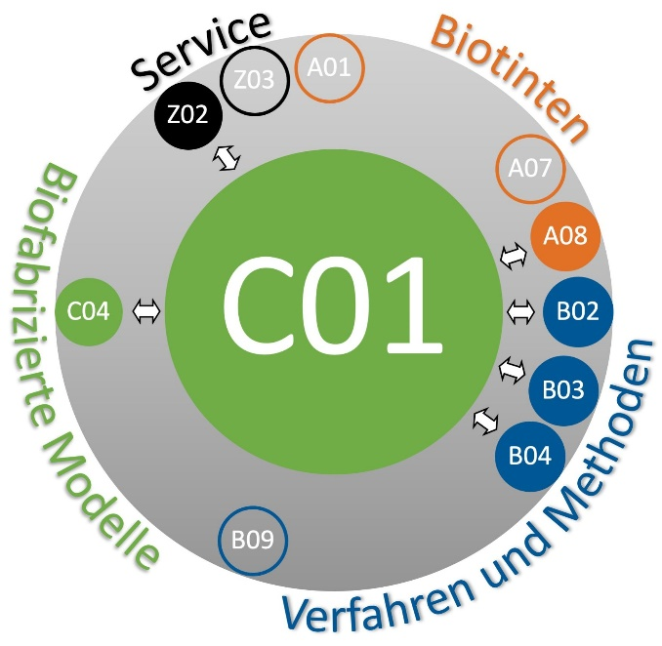
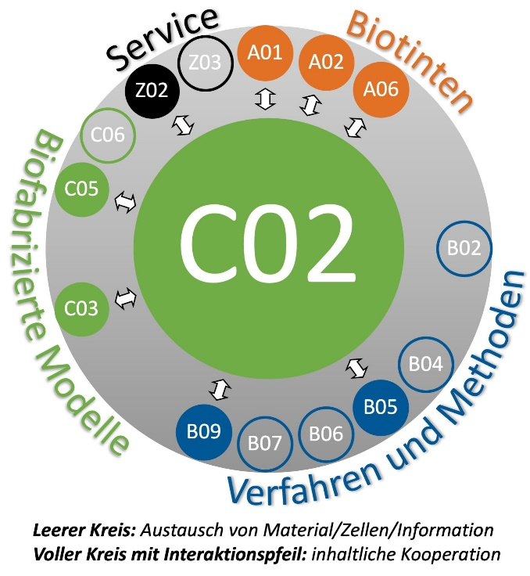
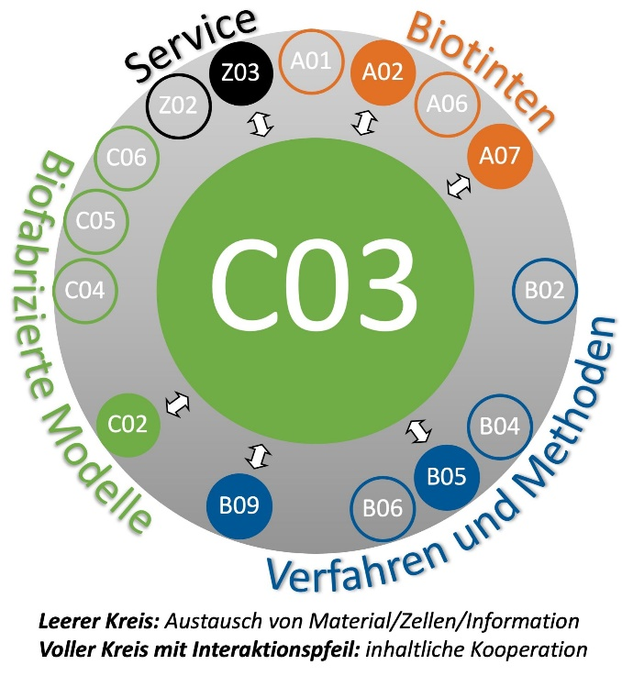
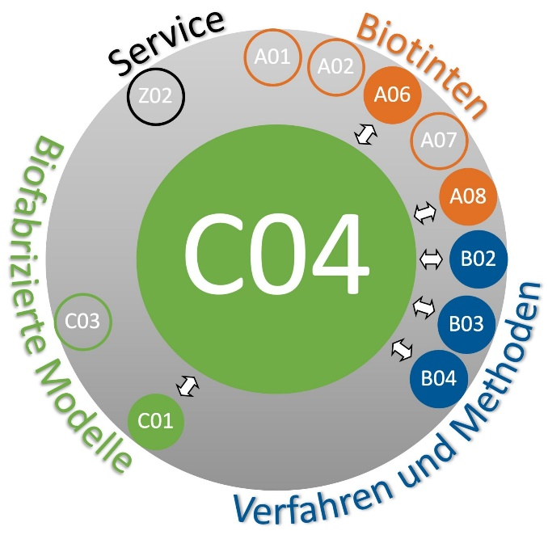
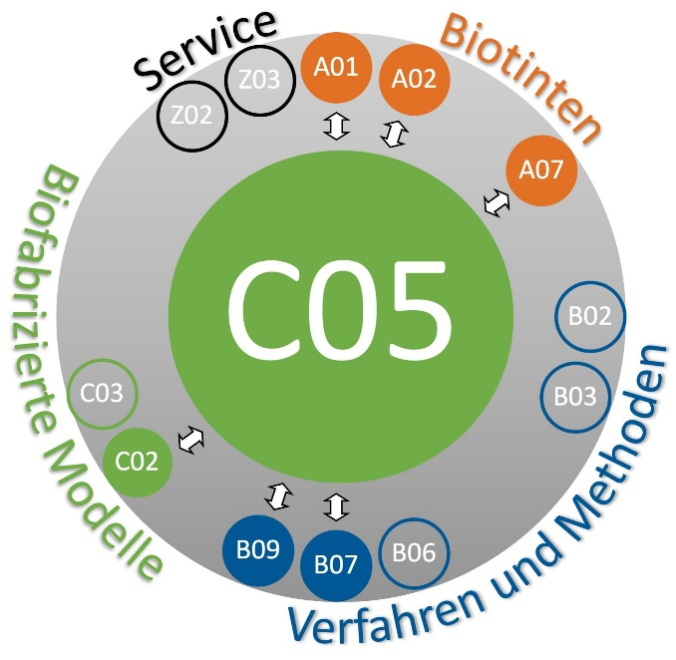
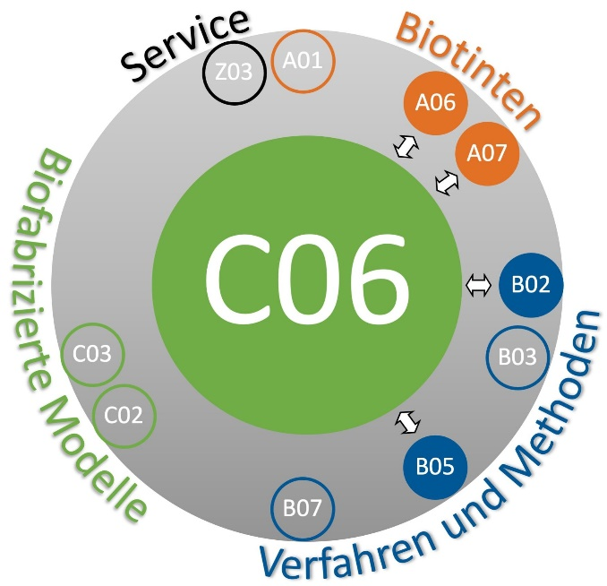
C-Subproject logos
Position within the SFB/ Interaction button

Slide 6
Project Logo
Size 10x15,7cm
Project Title
PI¹, PI² ,PI³, PhD¹, PhD², PhD³
¹Institute, University
²Institute, University
³Institute, University
Summary/Overview
Main results/Preliminary work
The quick brown fox jumps over the lazy dog. The quick brown fox jumps over the lazy dog. The quick brown fox jumps over the lazy dog. The quick brown fox jumps over the lazy dog. The quick brown fox jumps over the lazy dog.
The quick brown fox jumps over the lazy dog. The quick brown fox jumps over the lazy dog. The quick brown fox jumps over the lazy dog. The quick brown fox jumps over the lazy dog. The quick brown fox jumps over the lazy dog.
The quick brown fox jumps over the lazy dog. The quick brown fox jumps over the lazy dog. The quick brown fox jumps over the lazy dog. The quick brown fox jumps over the lazy dog. The quick brown fox jumps over the lazy dog.
The quick brown fox jumps over the lazy dog. The quick brown fox jumps over the lazy dog. The quick brown fox jumps over the lazy dog. The quick brown fox jumps over the lazy dog. The quick brown fox jumps over the lazy dog.
The quick brown fox jumps over the lazy dog. The quick brown fox jumps over the lazy dog. The quick brown fox jumps over the lazy dog. The quick brown fox jumps over the lazy dog. The quick brown fox jumps over the lazy dog.
The quick brown fox jumps over the lazy dog. The quick brown fox jumps over the lazy dog. The quick brown fox jumps over the lazy dog. The quick brown fox jumps over the lazy dog. The quick brown fox jumps over the lazy dog.
Work packages and methods
Integration into interdisciplinary topics
The quick brown fox jumps over the lazy dog. The quick brown fox jumps over the lazy dog. The quick brown fox jumps over the lazy dog. The quick brown fox jumps over the lazy dog. The quick brown fox jumps over the lazy dog.
The quick brown fox jumps over the lazy dog. The quick brown fox jumps over the lazy dog. The quick brown fox jumps over the lazy dog. The quick brown fox jumps over the lazy dog. The quick brown fox jumps over the lazy dog.
The quick brown fox jumps over the lazy dog. The quick brown fox jumps over the lazy dog. The quick brown fox jumps over the lazy dog. The quick brown fox jumps over the lazy dog. The quick brown fox jumps over the lazy dog.
The quick brown fox jumps over the lazy dog. The quick brown fox jumps over the lazy dog. The quick brown fox jumps over the lazy dog. The quick brown fox jumps over the lazy dog. The quick brown fox jumps over the lazy dog.
Position within the SFB
Interaction button 20x20cm
The quick brown fox jumps over the lazy dog. The quick brown fox jumps over the lazy dog.
The quick brown fox jumps over the lazy dog. The quick brown fox jumps over the lazy dog.
The quick brown fox jumps over the lazy dog. The quick brown fox jumps over the lazy dog.
Universitätsklinikum
Würzburg

Slide 7
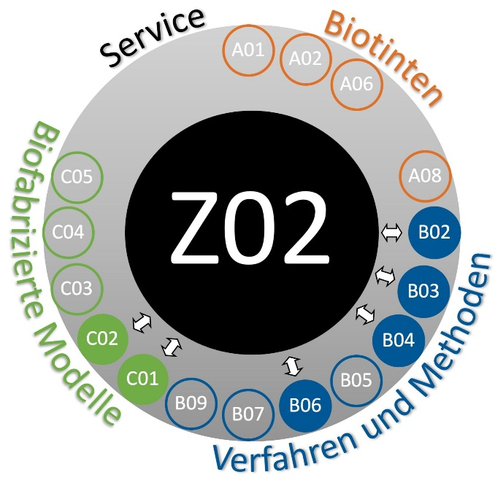
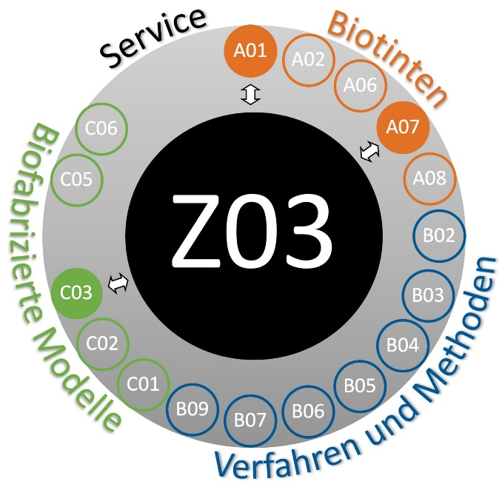
Z-Subproject logos
Position within the SFB/ Interaction button

Slide 8
Project Logo
Size 10x15,7cm
Project Title
PI¹, PI² ,PI³, PhD¹, PhD², PhD³
¹Institute, University
²Institute, University
³Institute, University
Summary/Overview
Main results/Preliminary work
The quick brown fox jumps over the lazy dog. The quick brown fox jumps over the lazy dog. The quick brown fox jumps over the lazy dog. The quick brown fox jumps over the lazy dog. The quick brown fox jumps over the lazy dog.
The quick brown fox jumps over the lazy dog. The quick brown fox jumps over the lazy dog. The quick brown fox jumps over the lazy dog. The quick brown fox jumps over the lazy dog. The quick brown fox jumps over the lazy dog.
The quick brown fox jumps over the lazy dog. The quick brown fox jumps over the lazy dog. The quick brown fox jumps over the lazy dog. The quick brown fox jumps over the lazy dog. The quick brown fox jumps over the lazy dog.
The quick brown fox jumps over the lazy dog. The quick brown fox jumps over the lazy dog. The quick brown fox jumps over the lazy dog. The quick brown fox jumps over the lazy dog. The quick brown fox jumps over the lazy dog.
The quick brown fox jumps over the lazy dog. The quick brown fox jumps over the lazy dog. The quick brown fox jumps over the lazy dog. The quick brown fox jumps over the lazy dog. The quick brown fox jumps over the lazy dog.
The quick brown fox jumps over the lazy dog. The quick brown fox jumps over the lazy dog. The quick brown fox jumps over the lazy dog. The quick brown fox jumps over the lazy dog. The quick brown fox jumps over the lazy dog.
Work packages and methods
Integration into interdisciplinary topics
The quick brown fox jumps over the lazy dog. The quick brown fox jumps over the lazy dog. The quick brown fox jumps over the lazy dog. The quick brown fox jumps over the lazy dog. The quick brown fox jumps over the lazy dog.
The quick brown fox jumps over the lazy dog. The quick brown fox jumps over the lazy dog. The quick brown fox jumps over the lazy dog. The quick brown fox jumps over the lazy dog. The quick brown fox jumps over the lazy dog.
The quick brown fox jumps over the lazy dog. The quick brown fox jumps over the lazy dog. The quick brown fox jumps over the lazy dog. The quick brown fox jumps over the lazy dog. The quick brown fox jumps over the lazy dog.
The quick brown fox jumps over the lazy dog. The quick brown fox jumps over the lazy dog. The quick brown fox jumps over the lazy dog. The quick brown fox jumps over the lazy dog. The quick brown fox jumps over the lazy dog.
Position within the SFB
Interaction button 20x20cm
The quick brown fox jumps over the lazy dog. The quick brown fox jumps over the lazy dog.
The quick brown fox jumps over the lazy dog. The quick brown fox jumps over the lazy dog.
The quick brown fox jumps over the lazy dog. The quick brown fox jumps over the lazy dog.
Universitätsklinikum
Würzburg

Slide 9
Farben im RGB Farbraum
Orange: R 226 G 113 B 37
Blau: R0 G 87 B 150
Grün: R112 G 173 B 69
Weinrot: R 182 G 59 B56

